Slide 1
LANGUAGE AND WRITING SKILLS
BY- VIDISHA KASHYAP

Slide 2

UNIT 2 ..

Slide 3
FOUNDATION OF ENGLISH LANGUAGE
What is essential to acquire a good foundation in English Language?
Listening
Reading
Writing
Speaking
Basic rules of Grammar serves as the foundation of English Grammar:
Nouns and Pronouns: Noun is a person, place, thing, animal or idea & Pronoun takes the place of a noun in a sentence, e.g: “WE”, “SHE”, “THEM”, “US” etc
Verb: Verbs are words that show an action.
e.g: Jennifer walked to the store.
VERB showing action

Slide 4

Adjectives: Descriptive words that modify nouns or pronouns.
Adverb: An adverb can modify a verb, adjective or another adverb.
Prepositions: connects a noun or pronoun to the rest of the sentence and explains the relationship between the object and the rest of the sentence.
Conjunctions: links words or phrases together.
Interjections: An interjection is a word in a sentence that is used to express emotion.

Slide 5
REVISION OF TENSES
TENSES: A tense is defined as a form of verb which indicates the time and the state of an action or event, also indicates whether a sentence (or verb) is an action in the past, the present or the future.
PRESENT
Simple Present Tense – I eat everyday
Present Continuous- I am eating right now
Present Perfect- I have walked recently
Present Perfect Continuous- I have been walking for three hours.

Slide 6
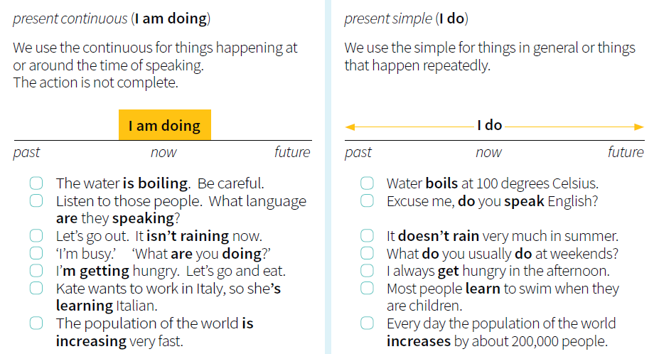

Slide 7
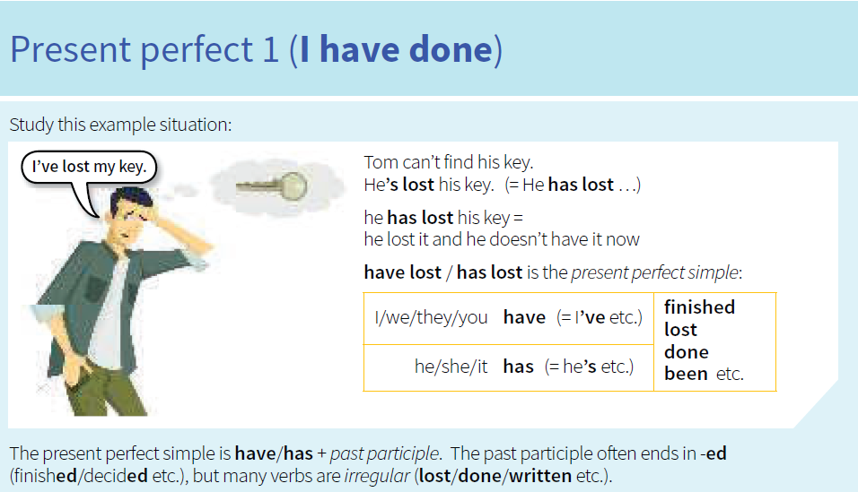

Slide 8
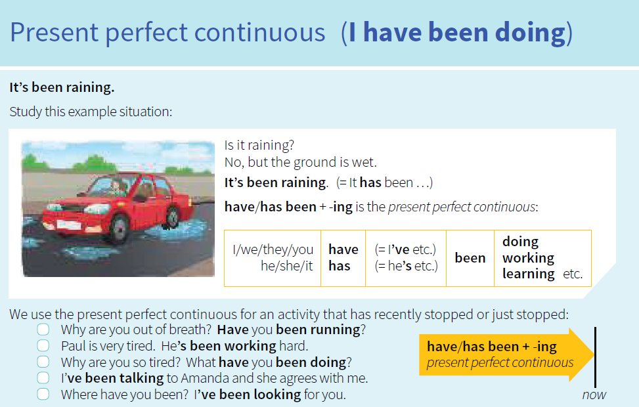

Slide 9
PAST
Simple Past- I walked last night
Past Continuous- I was eating last night
Past Perfect- I had walked before I slept
Past Perfect Continuous- I had been walking when the guests arrived.
FUTURE
Simple Future: I will walk tomorrow
Future Continuous: I will be walking tomorrow
Future Perfect: I will have walked by 8o’clock tonight
Future Perfect Continuous: I will have been walking when you arrive tomorrow.

Slide 10
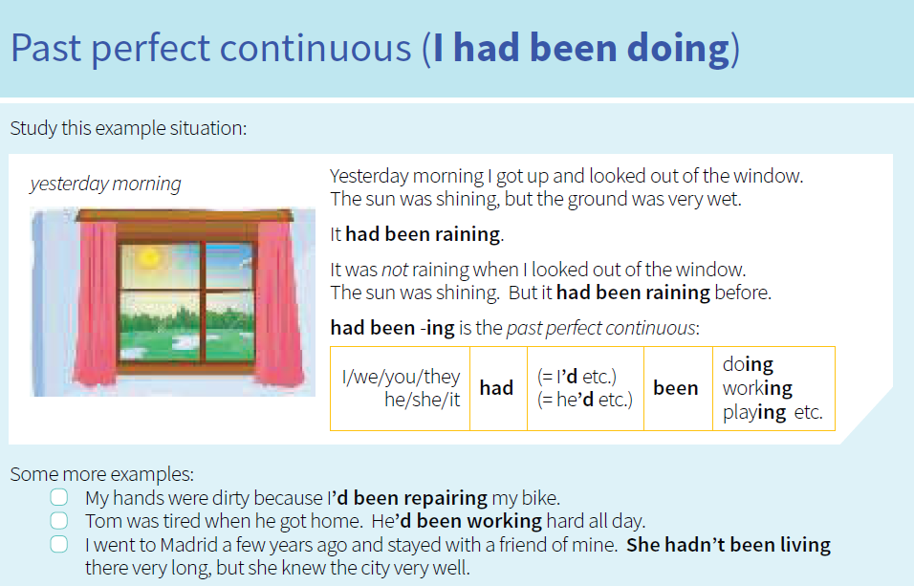

Slide 11
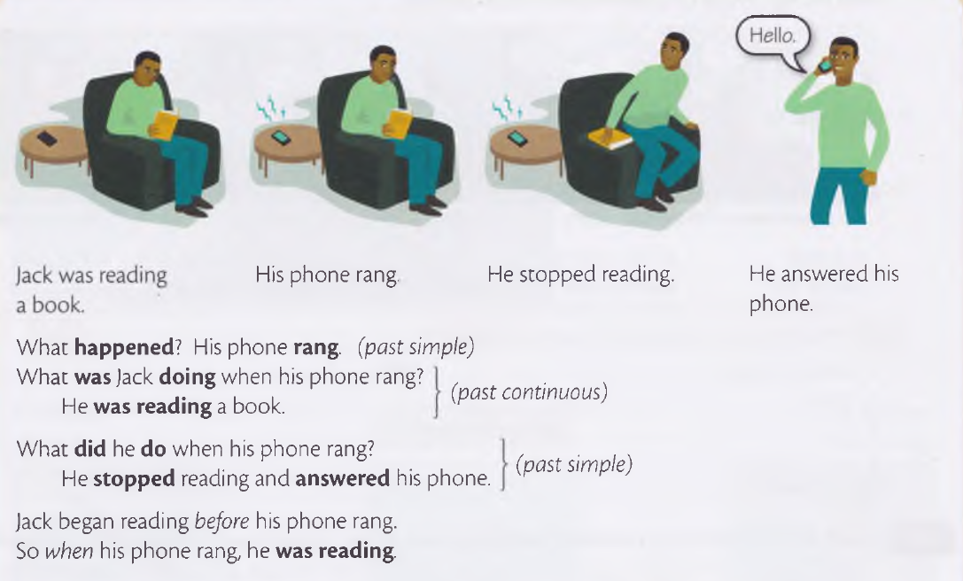
I was doing (Past Continuous) and I did (Simple Past)

Slide 12
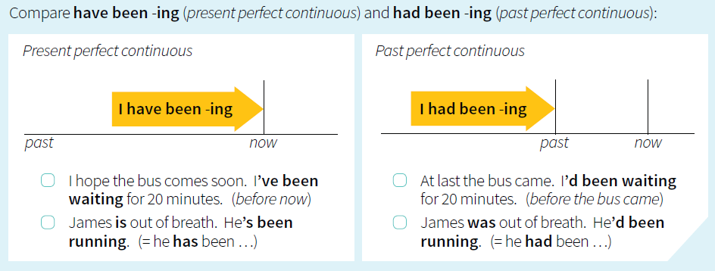

Slide 13
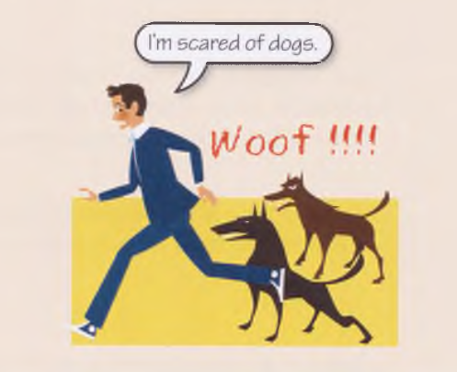
Present Tense
Present tense is a grammatical tense whose principal function is to locate a situation or event in the present time. It is used for actions which are happening now.
Steve is ill, He’s in bed.
My brother is scared of dogs.
It’s ten o’clock, you are late again.
I'm tired, but I'm not hungry.
Lisa isn't interested in politics. She's interested in art.

Slide 14
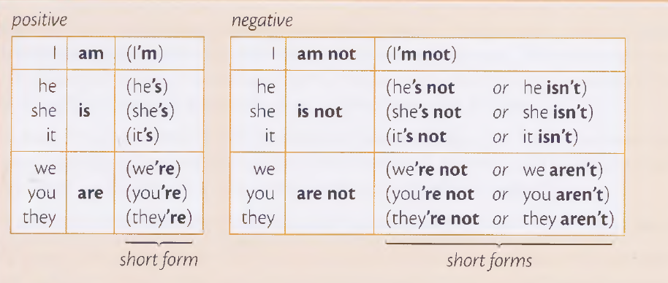

Slide 15

When do we use Simple Present Tense?
When do we use present continuous tense ?
When do we use Present Perfect Tense?
When do we use Present Perfect Continuous Tense?

Slide 16
Fill in the following blanks using the correct forms of the verbs in brackets. Use Simple Present, Present Continuous, Present Perfect, Present Perfect Continuous.
SIMPLE PRESENT
Meena (dance) on the stage.
The last bus normally (leave) at midnight.
He (not have) dinner at 8 p.m.
PRESENT CONTINUOUS
4. She (not work) she (play) chess with her friends.
5. She (leave) for America next year.
6. What you (read) at present? I (read) a poem.
7. We (have) lunch at 2.00 tomorrow as Ram (catch) a noon train.

Slide 17

PRESENT PERFECT
8. Have you taken lunch?
Yes, I ……..
9. Have you prepared your lesson?
Yes, I …….
10. Have you seen such a nice movie?
No, I …..
Yes, I ….. Last year.
11. Have you opened bank account?
Yes, I ….. Only Yesterday.
12. How long have you known this man?
I …. him since I arrived here.

Slide 18
PRESENT PERFECT CONTINUOUS
They (talk) for the last hour.
She (work) at that company for three years.
James (teach) at the university since June.
We (wait) here for over two hours.

Slide 19
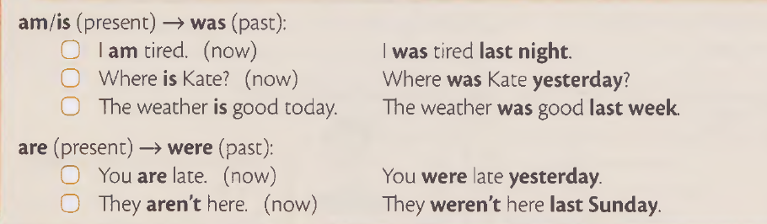
Past Tense
PAST TENSE:
The simple past tense is used for actions that started and ended at a specific point in time. It is formed by adding “ed” to the infinitive form of the verb.

Slide 20
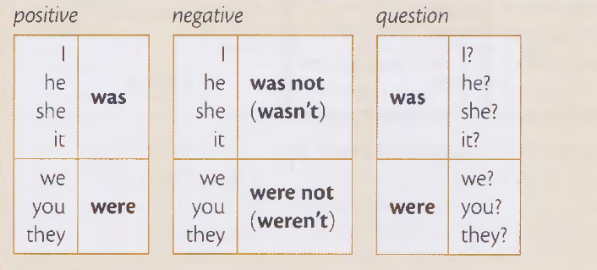

Slide 21
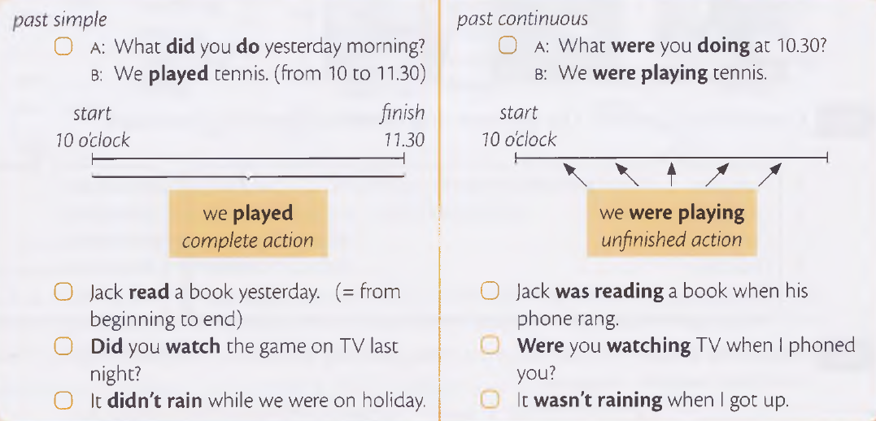

Slide 22
When do we use Simple Past Tense?
When do we use past continuous tense ?
When do we use Past Perfect Tense?

Slide 23
Fill in the following blanks using the correct forms of the verbs in brackets. Use Simple Past, Past Continuous, Past Perfect, Past Perfect Continuous.
We (hear) a terrifying news last night.
They (celebrate) their success two days ago.
The police (catch) the dacoits at 9.00 p.m.
Seema (not find) her lost book an hour before.
My cousin wears sandals but when I last saw him he (wear) boots.
On the beach many children (play) and many girls (swim) in the sea.
As she (climb) the stairs, she slipped and fell.
The teacher went to see what the students (do) in the garden.
SIMPLE PAST
PAST CONTINUOUS

Slide 24
After the guests (leave) we did the washing.
She (type) all the material by last evening.
We (finish) shopping before it started raining.
The house (belong) to him since his birth.
She was not present because she (leave) office when her boss called her.
He (play) football for two hours.
The child (study) since morning.
She (draft) the plan for a meeting for two hours.
I (play) my favourite game.
They (work) in this office since last year.
PAST PERFECT
PAST PERFECT CONTINUOUS

Slide 25
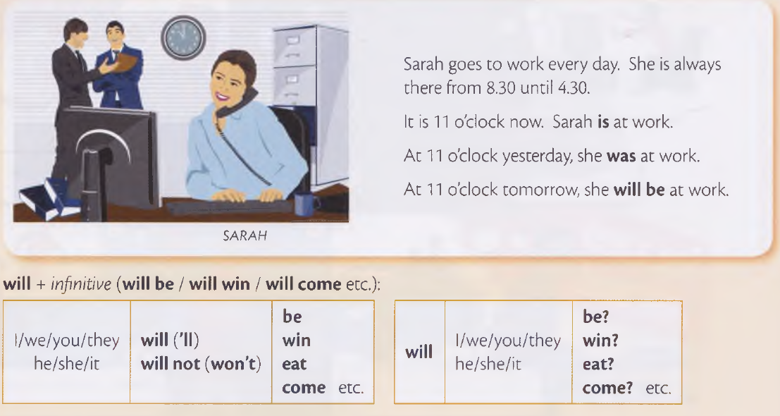
Future Tense

Slide 26
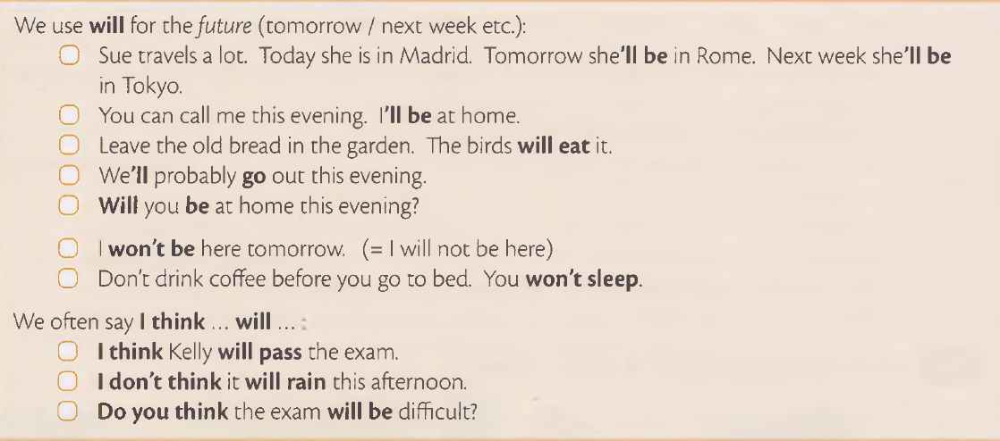

Slide 27
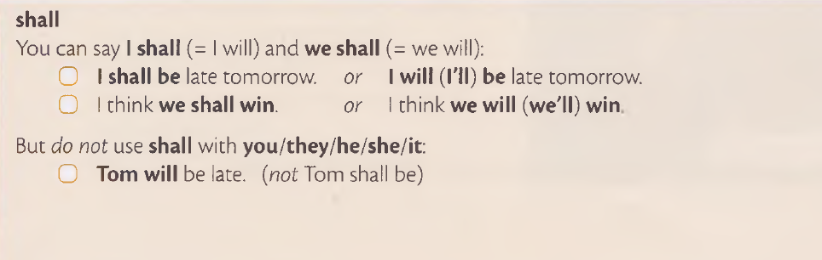
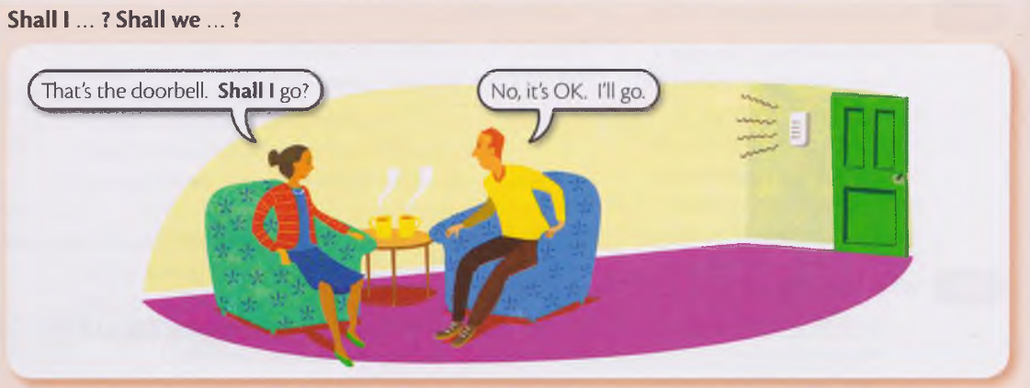

Slide 28
SIMPLE FUTURE
I (meet) my friend tomorrow.
You (join) college next year.
He (come) shortly.
I am sure he (come) in time for the class
You (speak) English after another two months of hard work.
FUTURE CONTINUOUS
He (work) for Mr. Kapoor next week as his own assistant is expected to be on leave.
In a few years time we all (live) in multi-storeyed houses.
We (behave) ourselves in school today as our principal’s mood is very upset now-a-days.
My brother (not drink) at the party tonight as mother is likely to be present there.
He surely (smoke) if you visit his room now.

Slide 29
FUTURE PERFECT
I (complete) this essay by tomorrow morning.
At the rate he is studying he (qualify) by next year.
The ship (leave) before we reach the harbour.
If he continues with his exercises he (lose) 10 kg by the end of this month.
She (know) me for five years next month.
FUTURE PERFECT CONTINUOUS
He will be tired when he gets here. He (travel) all day.
Next month I (study) Chinese for two years.
Ram (wait) for an hour by the time I meet him.

Slide 30


